Slide 1


WELCOME
TO
ENGLISH 7

Slide 2
REVISION:
1/ SIMLPE PRESENT TENSE (Thì hiện tại đơn)
(+) S + V + (s / es) (-) S + do / does + not + V (?) Do / Does + S + V ?
* Adverbs of frequency: (Trạng từ chỉ sự thường xuyên)
*Always/ Usually/ Sometimes/ Often/ Never/ Every….
2/ PRESENT CONTINUOUS TENSE: (Thì hiện tại tiếp diễn)
(+) S + am/ is/ are + V+ing (-) S + am/ is/ are + not + V+ing (?) Is/ Are + S + V +ing ?
*Adverbs: Now/ At the moment/ At present…
*Imperative: Look/ Listen/ Hurry up…
3/ a/SIMLPE FUTURE TENSE: (Thì tương lai đơn)
(+) S + will + V (-) S + will + not + V (?) Will + S + V …?
b/Near Future (Tương lai gần)
(+) S + be + going to + V (-) S + be not + going to + V (?) Be + S + going to + V…?
*Adverbs: Next month/ Year/ Week, Tomorrow, Soon…

Slide 3
Tuần 1: Tiết 1
ÔN TẬP ĐẦU NĂM
A/ Bài tập thì Hiện Tại Đơn / Hiện tại tiếp diễn:
1. Where ______you (live)_______? I (live) ________in Hai Duong town.
2. What he (do) _____________now? He (water) __________flowers in the garden.
3. What _________she (do) ________? She (be) __________a teacher.
4. Where ___________you (be) from?
5. At the moment, my sisters (play)_________volleyball and my brother (play) ___________soccer.
6. it is 9.00; my family (watch)_____________TV.
7. In the summer, I usually (go)__________to the park with my friends, and in the spring, we (have) ________Tet Holiday; I (be)______happy because I always (visit) ___________my grandparents.
8. _________your father (go)_________to work by bus?
9. How __________your sister (go)__________to school?
10. What time ____________they (get up)_____________?
11. What _________they (do)___________in the winter?
12. Today, we (have)___________English class.
13. Her favorite subject (be)____________English.
14. Now, my brother (like)___________eating bananas.
15. Look! A man (call)____________you.

Slide 4
B/ Hiện Tại Đơn / Hiện Tại Tiếp Diễn/ Tương Lai Gần:
1. The meeting _______________ (take) place at 6 p.m.
2. I'm afraid I _______________ (not / be) able to come tomorrow.
3. Because of the train strike, the meeting _______ (not / take) place at 9 o'clock.
4. According to the weather forecast, it ___________ (not / snow) tomorrow.
5. _______________ (they / come) tomorrow?
6. When ____________ (you / get) back?
7. If you lose your job, what ____________ (you / do)?
8. In your opinion, _______________ (she / be) a good teacher?
9. What time _______________ (the sun / set) today?
10. ___________ (she / get) the job, do you think?
11. _______________ (David / be) at home this evening?
12. What ______________ (the weather / be) like tomorrow?
13. There’s someone at the door, _____________ (you / get) it?
14. How _________________ (he / get) here?
15. ______________ (they / come) tomorrow?

Slide 5
ĐÁP ÁN
Bài tập A
1. Do, live, live. 2. What is he doing now? He is watering flowers in the garden. 3. What does she do? She is a teacher. 4. Where are you from? 5. are playing, is playing. 6. is watching. 7. go, have, am, visit. 8. Does your father go to work by bus? 9. How does your sister go to school? 10. What time do they get up? 11. What do they do in the winter? 12. have 13. is 14. likes (* Lưu ý: Tuy là trong câu có “now”- dấu hiệu của hiện tại tiếp diễn, nhưng ta không được chia động từ “ like “ thành dạng V-ing, nên ta phải dùng thì hiện tại đơn trong trường hợp này). 15. is calling.

Slide 6
Đáp án bài tập B
is going to take
am not going to be
isn’t going to take
isn’t going to snow
Are they going to come tomorrow?
When are you going to get back?
If you lose your job, what are you going to do?
In your opinion, she is going to be a good teacher?
What time is the sun going to set today?
Is she going to get the job, do you think?
Is David going to beat home this evening?
What is the weather going to be like tomorrow?
There’s someone at the door, are you getting it?
How does he get there?
Are they going to come tomorrow?

Slide 7
C/ REWRITE:
1. My sister walks to the supermarket.
My sister goes……………………………………………………………………
2. There are many flowers in our garden.
Our garden………………………………………………………………………
3. Does your father cycle to work?
Does your father get……………………………………………………………
4. The garden is behind Nam’s classroom.
Nam’s classroom…………………………………………………………………
5. Tom drives to work every morning.
Tom travels………………………………………………………………………
6. There are four people in her family.
Her family…………………………………………………………………………
7. My house is behind the hotel.
The hotel………………………………………………………………………….
8. Does your class have twenty - five students?
Are…………………………………………………………………………………
9. He goes to work at seven fifteen.
He goes to work at a………………………………………………………………
10. The drug store is to the right of the bakery.
The bakery…………………………………………………………………

Slide 8
ĐÁP ÁN BÀI TẬP C:
1/ ….. on foot to the supermarket.
2/ ….. has many flowers.
3/ ….. to work by bicycle.
4/ ….. is in front of the garden.
5/ ….. to the work by car every morning.
6/ ….. has 4 people.
7/ ….. is in front of my house.
8/ ….. there 25 students in your class.
9/ ….. quarter past seven.
10/ … is to the left of the drug store.

Slide 9

TiẾT 2
UNIT ONE

Slide 10
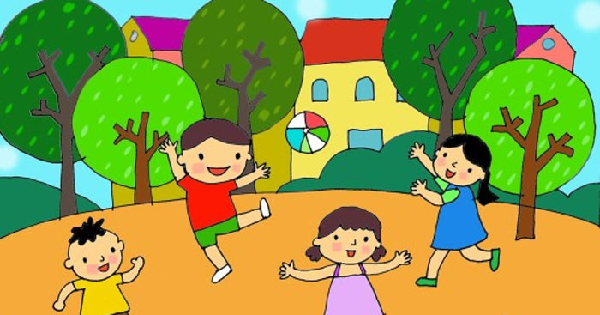
A/ FRIENDS:
A. 1/ Listen. Then practice with a partner:
a/ Ba: Hello, Nga.
Nga: Hi, Ba. Nice to see you again.
Ba: Nice to see you, too.
Nga: This is our new classmate. Her name’s Hoa.
Ba: Nice to meet you, Hoa.
Hoa: Nice to meet you, too.
NEW WORDS:
Nice to see you.
= Nice to meet you: rất vui được gặp bạn
Classmate (N): bạn cùng lớp
Roommate (N): bạn cùng phòng
Teammate (N): bạn đồng đội

Slide 11
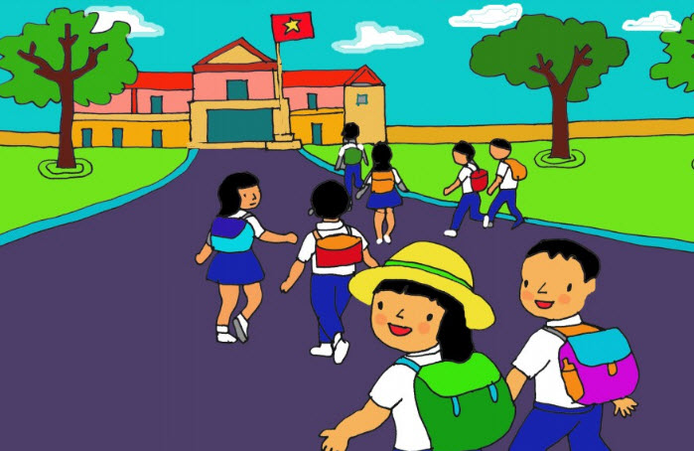
b/ Hoa: Good morning. My name’s Hoa.
Nam: Nice to meet you, Hoa. My name’s Nam.
Are you a new student?
Hoa: Yes, I’m in class 7A.
Nam: Oh, so am I.
NEW WORDS:
Friend (N): bạn, bạn bè
Friendly (Adj): thân thiện
Friendship (N): tình bạn, tình hữu nghị
- So am I / I am, too/ Me, too: tôi cũng vậy
Now answer:
a/ What is the new girl’s name? → Her name is Hoa.
b/ What class is she in? → She is in class 7A.
c/ Who is also in class 7A? → Nam is also in class 7A.

Slide 12
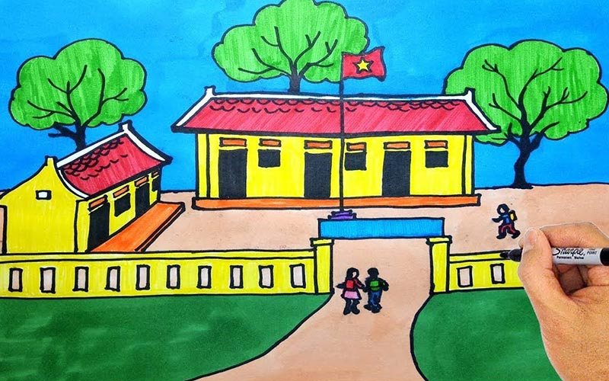
A.2/ Read. Then answer the questions:
Hoa is a new student in class 7A. She is from Hue and her parents still live there. She lives with her uncle and aunt in Ha Noi.
Hoa has lots of friends in Hue. But she doesn’t have any friends in Ha Noi. Many things are different. Her new school is bigger than her old school. Her new school has a lot of students. Her old school doesn’t have many students.
Hoa is unhappy. She misses her parents and her friends.
NEW WORDS:
Parents (N): Bố Mẹ/ Parent (N); Bố hoặc Mẹ
still : vẫn còn
different….from (Adi) khác với
difference (N): sự khác nhau, khác biệt
differently (Adv): một cách khác nhau
a lot of/ lots of : nhiều
big/ bigger: lớn/ lớn hơn
happy =/= unhappy (Adj): vui =/= không vui
miss/ misses (V): nhớ, bỏ lỡ
Questions:
a/ Where is Hoa from? → She is from Hue.
b/ Who is she staying with? → She is staying with her uncle and aunt.
c/ Does she have a lot of friends in Ha Noi? →No, she doesn’t.
d/ How is her new school different from her old school? →…is bigger than her old school.
e/ Why is Hoa unhappy? → Because she misses her parents and her friends.

Slide 13
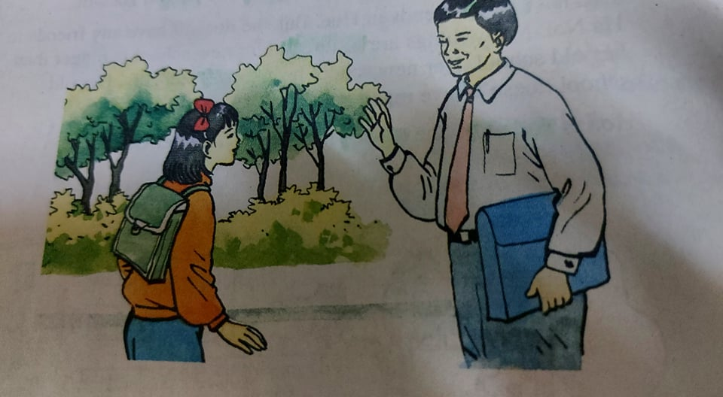
A 3/ Listen. Then practice with a partner:
Nga: Good morning, Mr. Tân.
Mr. Tân: Good morning, Nga. How are you?
Nga: I’m very well, thank you. And you?
Mr. Tân: I’m fine, thanks. Good bye. See you later.
Nga: Good bye.

Slide 14
TiẾT 3:
A 4/ Listen. Complete these dialogue:
a/ Mr. Tan: Hello, Lien. How are you?
Miss. Lien: Pretty good, thank you. How about you, Tan?
Mr. Tan: Not bad, but I’m very busy.
Miss. Lien: Me, too.
b/ Nam: Good afternoon, Nga. How is everything?
Nga: Ok, thanks. How are you today, Nam?
Nam: Just fine, thanks.
Nga: I’m going to the lunch room.
Nam: Yes. So am I.
REMEMBER:
a/ I’m in class 7A.
So am I. / I am, too (Tôi cũng vậy)
b/ a lot of / lots of / many ( nhiều) + danh từ số nhiều đếm được.
EX: She has a lot of / lots of friends.
Many things are different.
c/ So sánh hơn của tính từ ngắn: Adj + ER+ than
EX: Her new school is bigger than her old school.

Slide 15
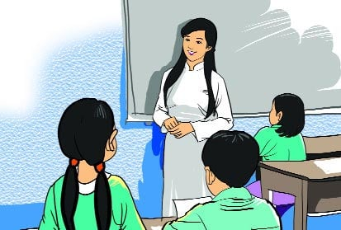
TUÂN 2: Tiết 4
UNIT ONE: Back to school (Cont)
B/ NAMES AND ADDRESSES: (page 15)
B1/ Listen. Then practice with a partner:
Miss Lien: What’s your family name, Hoa?
Hoa: It’s Pham. My middle name’s Thi.
Miss Lien: How old are you?
Hoa: I’m 13.
Miss Lien: Where do you live?
Hoa: 12 Tran Hung Dao Street.
Miss Lien: Thank you, Hoa.
*family name: họ = surname
What’s your family name?: Họ của bạn là gì?
What’s your full name? Tên họ của bạn là gì?
*middle name: tên lót
My middle name’s …. Tên lót của tôi là…
Where do you live? Bạn sống ở đâu?
What’s your address? Địa chỉ của bạn ở đâu?
*in HCM City / *on THD Street / * at 12 Le Van Si Street.
Now answer:
a/ Who is Hoa talking? Hoa is talking to Miss lien.
b/ What is Hoa’s family name? It’s Pham.
c/ What is her middle name? Her middle name is Thi
d/ Where does she live? She live at 12 Tran Hung Dao Street.

Slide 16
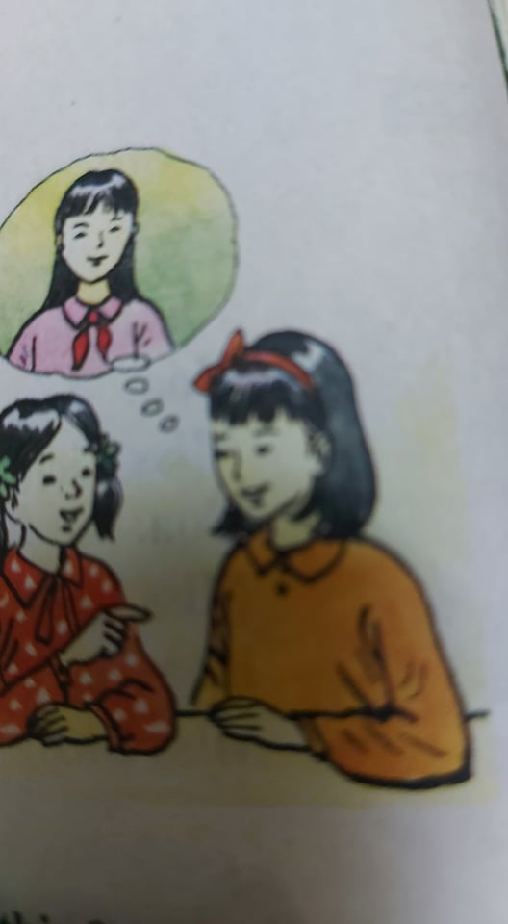
B 2/ Write. Complete this dialogue: (page16)
Nga: Who is that ?
Lan: That’s Nam.
Nga: no. Who is the girl talking to Miss lien?
Lan: Her name’s Hoa. She’s a new student.
Nga: Which / What class is she in?
Lan: She’s in our class – class 7 A.
Nga: Where does she live?
Lan: She lives on Tran Hung Dao Street with her aunt
and uncle.
Nga: Where do her parents live?
Lan: They live in Hue.
Nga: She’s tall. How old is she?
Lan: She’s 13.
B 3/ Ask your partner questions and complete this form:
NAME: What’s your name? My name’s Minh.
AGE: How old are you? I’m 13 years old.
GRADE: Which grade are you in? I’m in class 7 A
SCHOOL: Which school are you in? I’m in Bach Dang School.
HOME ADDRESS: What’s your address? My address is at 12 THD Street.

Slide 17
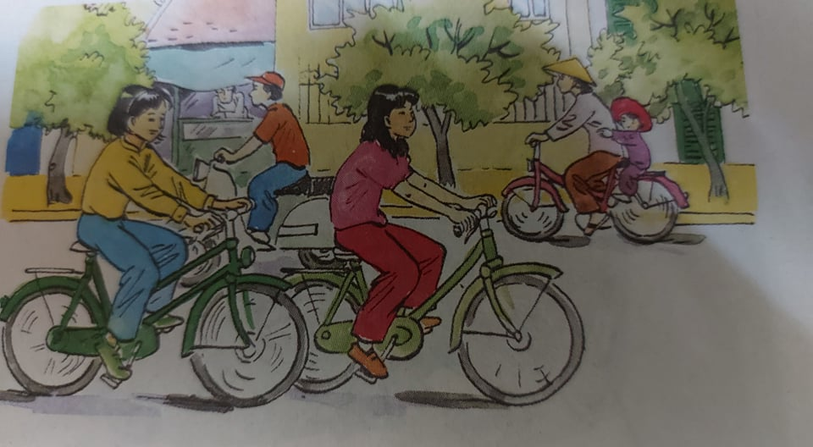
Tiết 5: B 4/ Listen. Then practice with a partner.
Nam: Where do you live, Hoa?
Hoa: I live at 12 Tran Hung Dao Street.
Nam: How far is it from your house to school?
Hoa: It’s not far – about one kilometer.
Nam: How do you go to school?
Hoa: I go to school by bike.
STRUCTURES:
1/ Hỏi, Trả lời về khoảng cách giữa 2 địa điểm:
HOW FAR + is + it + from ….. + to…..?
It’s + (about) + khoảng cách (meter/ kilometer)
EX: How far is it from your house to BD school? → It’s about one kilometer.
How far is it from your house to NVT market? → It’s 500 meters.
2/ Hỏi, Trả lời về phương tiện đi lại:
How do you go to school? → I go to school by bike./ by bus/ go on foot
How does she/ he go to school/ → She/ He goes to school by motorbike.

Slide 18
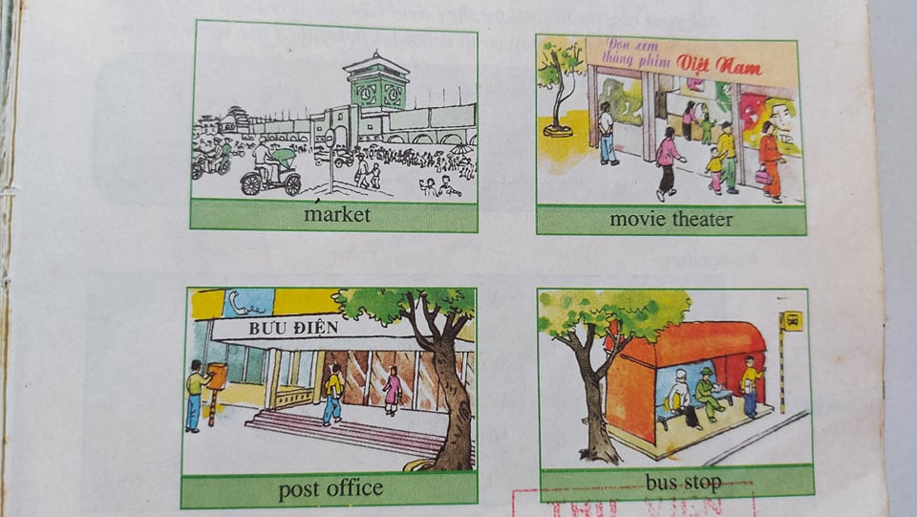
B 5/ Ask and answer with a partner: (page17)
How far is it from your house to school?
It’s …….
1/ Market
How far is it from your house to the market?
It’s (about) 500 kilometers.
2/ Movie theater
____________________________________________________________________________
3/ Post office
____________________________________________________________________________
4/ Bus stop
____________________________________________________________________________

Slide 19
Tiết 6: GRAMMAR
I/ Comparative and Superlative Adjectives:
a/ Comparative: * (short) Adj + ER + than…
* More + (long) Adj + than …
Ex: Lan is taller than Hoa.
Nam is more intelligent than minh.
b/ Superlative: * The (short) Adj + EST
* The most + (long) Adj
Ex: Tam is the tallest boy in my class.
She is the most beautiful girl.
2/ WH- Questions: Các nghi vấn từ: What/ Where/ Who/ Why/ When/ How…
Ex: What’s your name?/ Where do you live?/ How do you go to school?/ How old are you?....
3/ *A lot of/ Lots of + Danh Từ đếm được số nhiều và DT không đếm được.
Ex: I have a lot of friends in BD school./ I have a lot of time./ I like black coffee with lots of sugar.
*Many + Danh từ đếm được số nhiều.
Ex: Many people agree with me about it./ How many books have you got?
* Much + Danh từ không đếm được
Ex: I have much difficulty in studying English./ How much water do you need?
Note: Many và Much được dùng trong câu hỏi và phủ định.
A lot of được dùng trong câu khẳng định.
Ngoại lệ: *Good/ Better/ The best
*Bad/ Worse/ The worst
*Little/ Less/ The least
*Many, Much/ More/ The most

